Slide 1

Meet
Your Learning companion

Slide 2

ABSTRACT
EduBridge is a learning/educational platform, that is made to change the landscape of online education. EduBridge serves as a link between educators and students, it will serve efficient and effective transfer of knowledge and resources. What makes EduBridge different is not just its role in quality education, but also its system which is designed to have active participation and reward both the instructors and the students for their contributions to the learning community.

Slide 3
KEY FEATURES OF THE WEB APPS
EduBridge offers an uninterrupted learning environment, free from the distractions of advertisements, allowing users to focus solely on their educational objectives.
Courses on EduBridge are organized, making it easier for students to follow and for instructors to organize their teaching materials.
EduBridge enables users to download videos and access them offline, ensuring learning is never interrupted by connection issues.
Users can quickly find specific topics, courses, or resources, making navigation and knowledge more efficient on the platform.

Slide 4
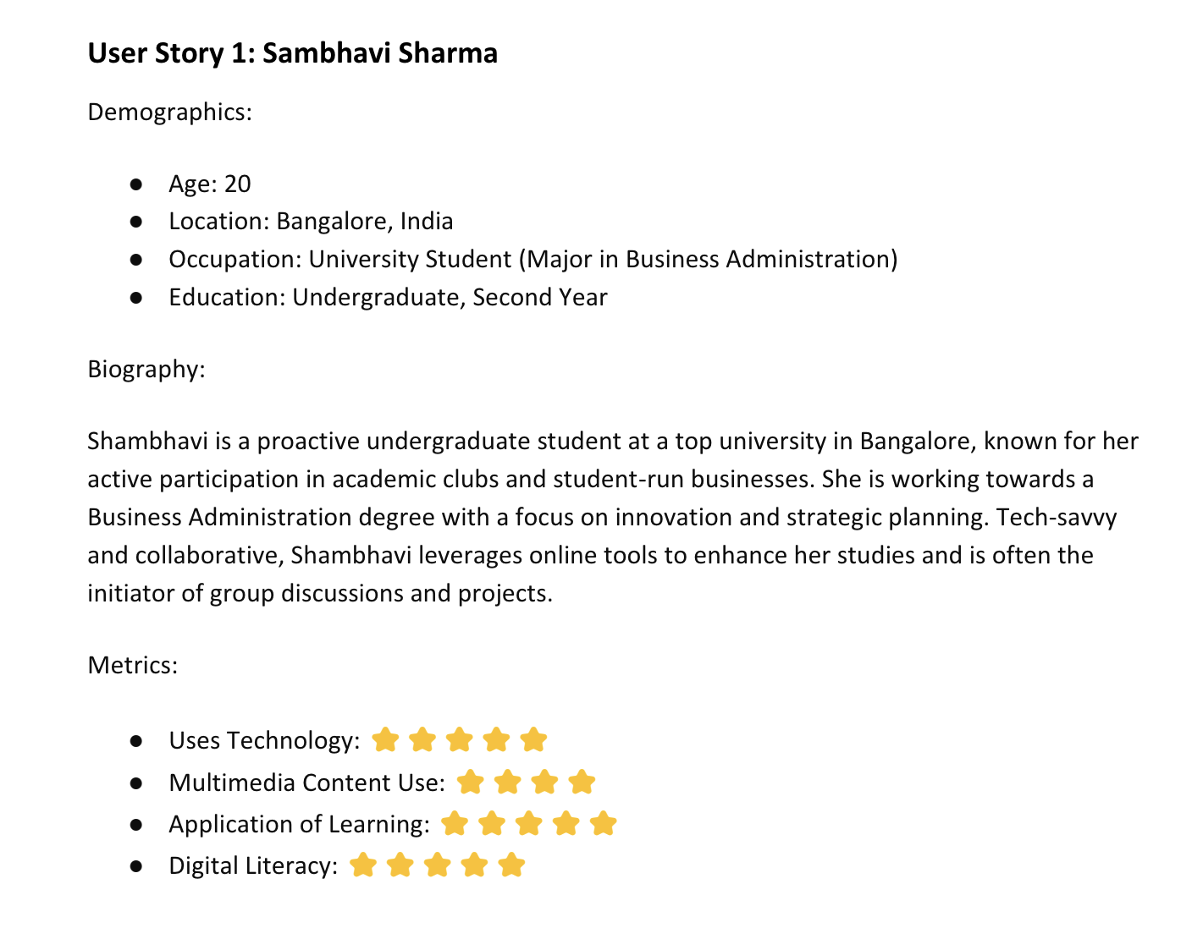
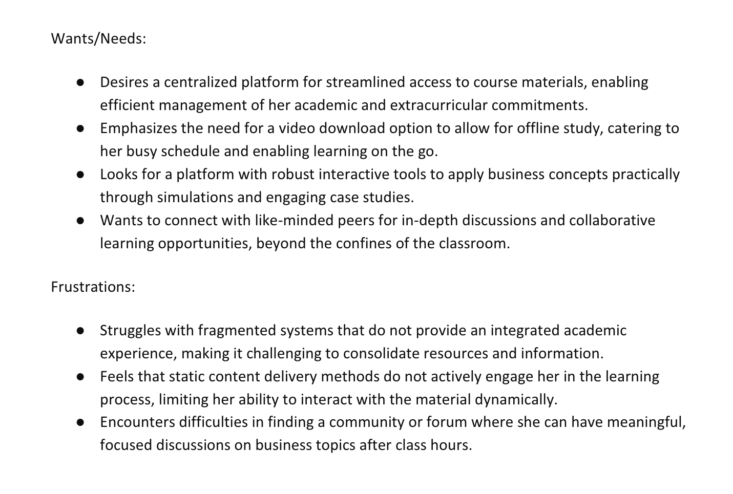
Usability

Slide 5
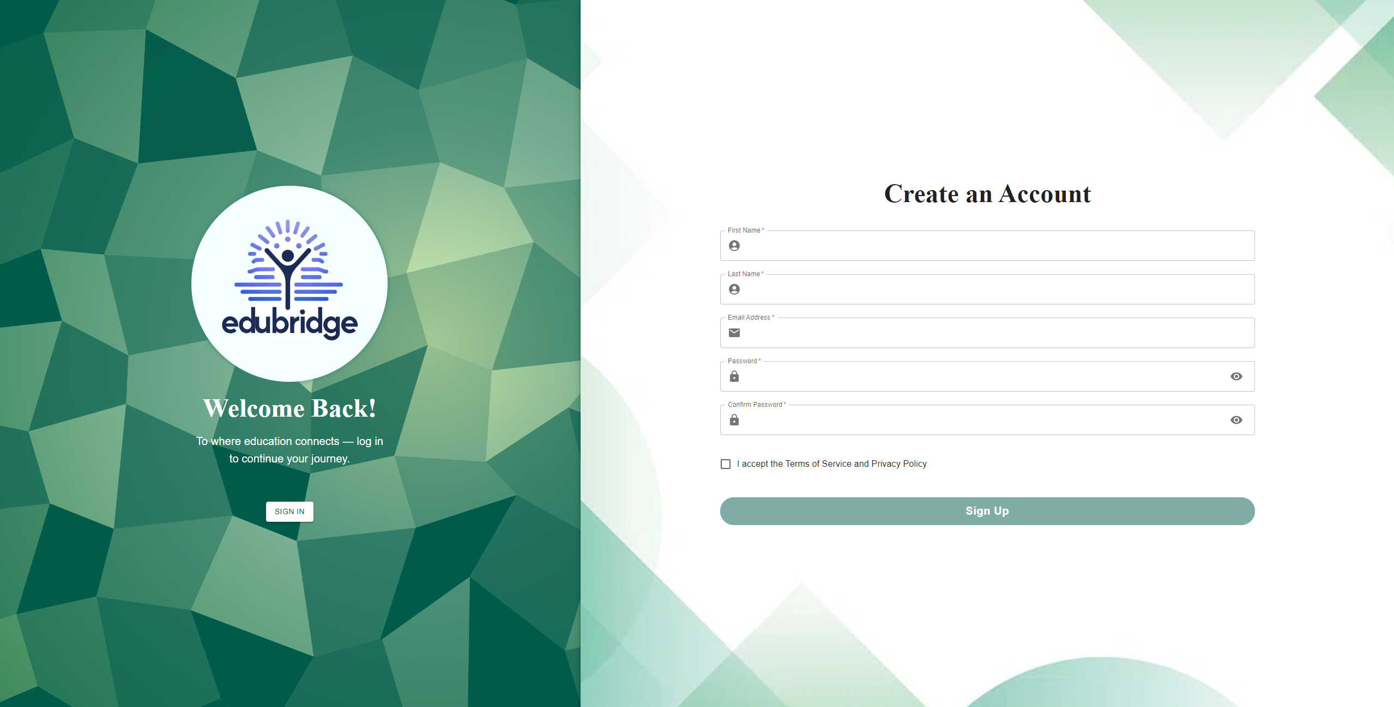
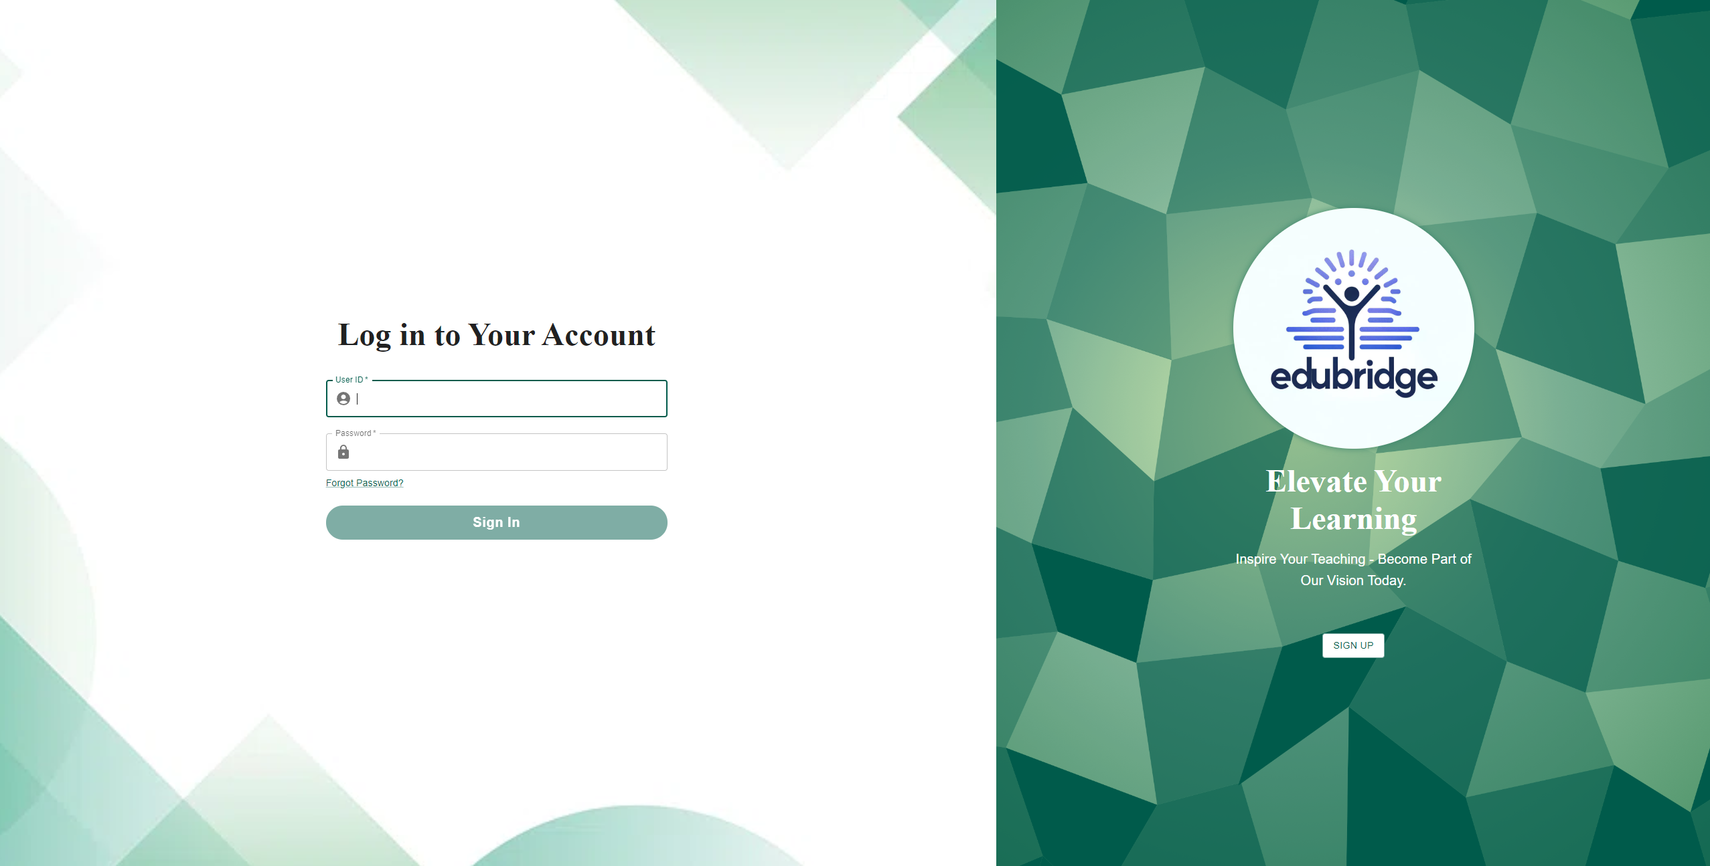
User Creation and Management
Users can register and log in. There are certain roles such as admin, student, and instructor.
By default every user registered is a student.
Currently without access to SF State Database, only admins can change a role of a user from Student to Instructor and vice-versa.

Slide 6
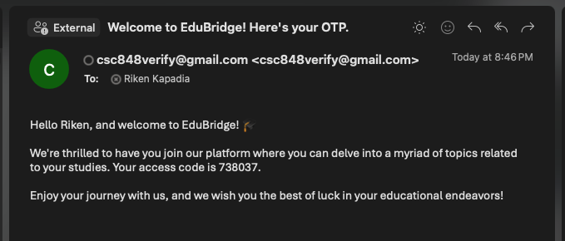
Student Authentication
Users can only be allowed to register with a “.edu” email. User need to access this email to retrieve an OTP to verify the email.

Slide 7
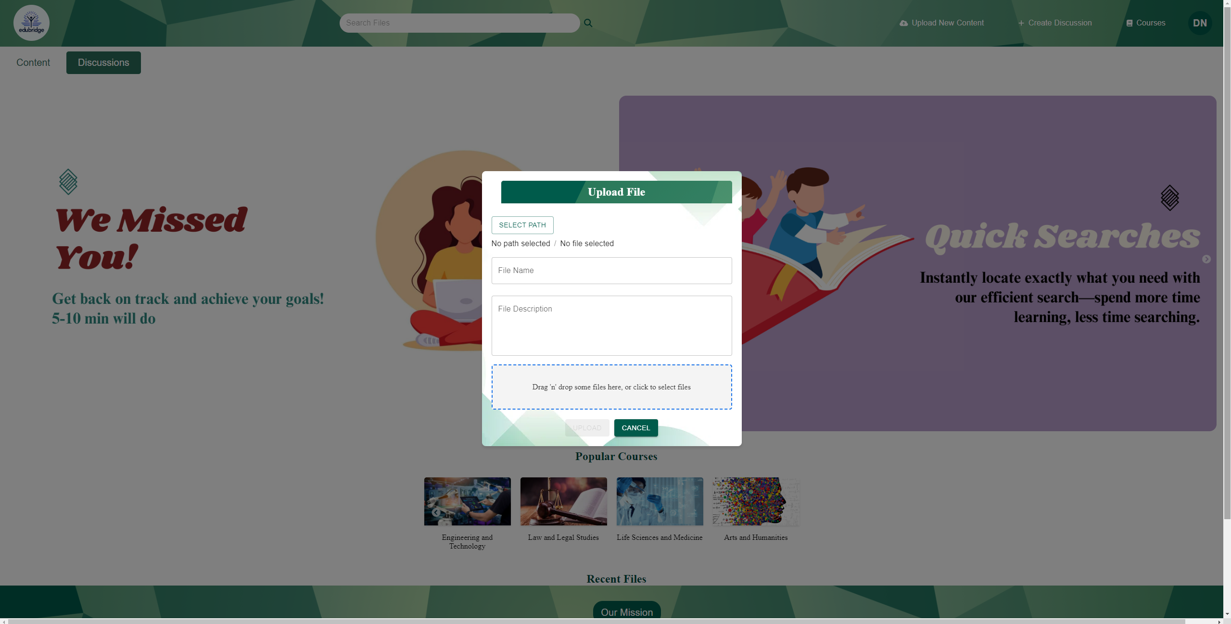
Content Upload
Users specifically instructors can upload diverse types of content.
User can download content from the platform for offline viewing.

Slide 8
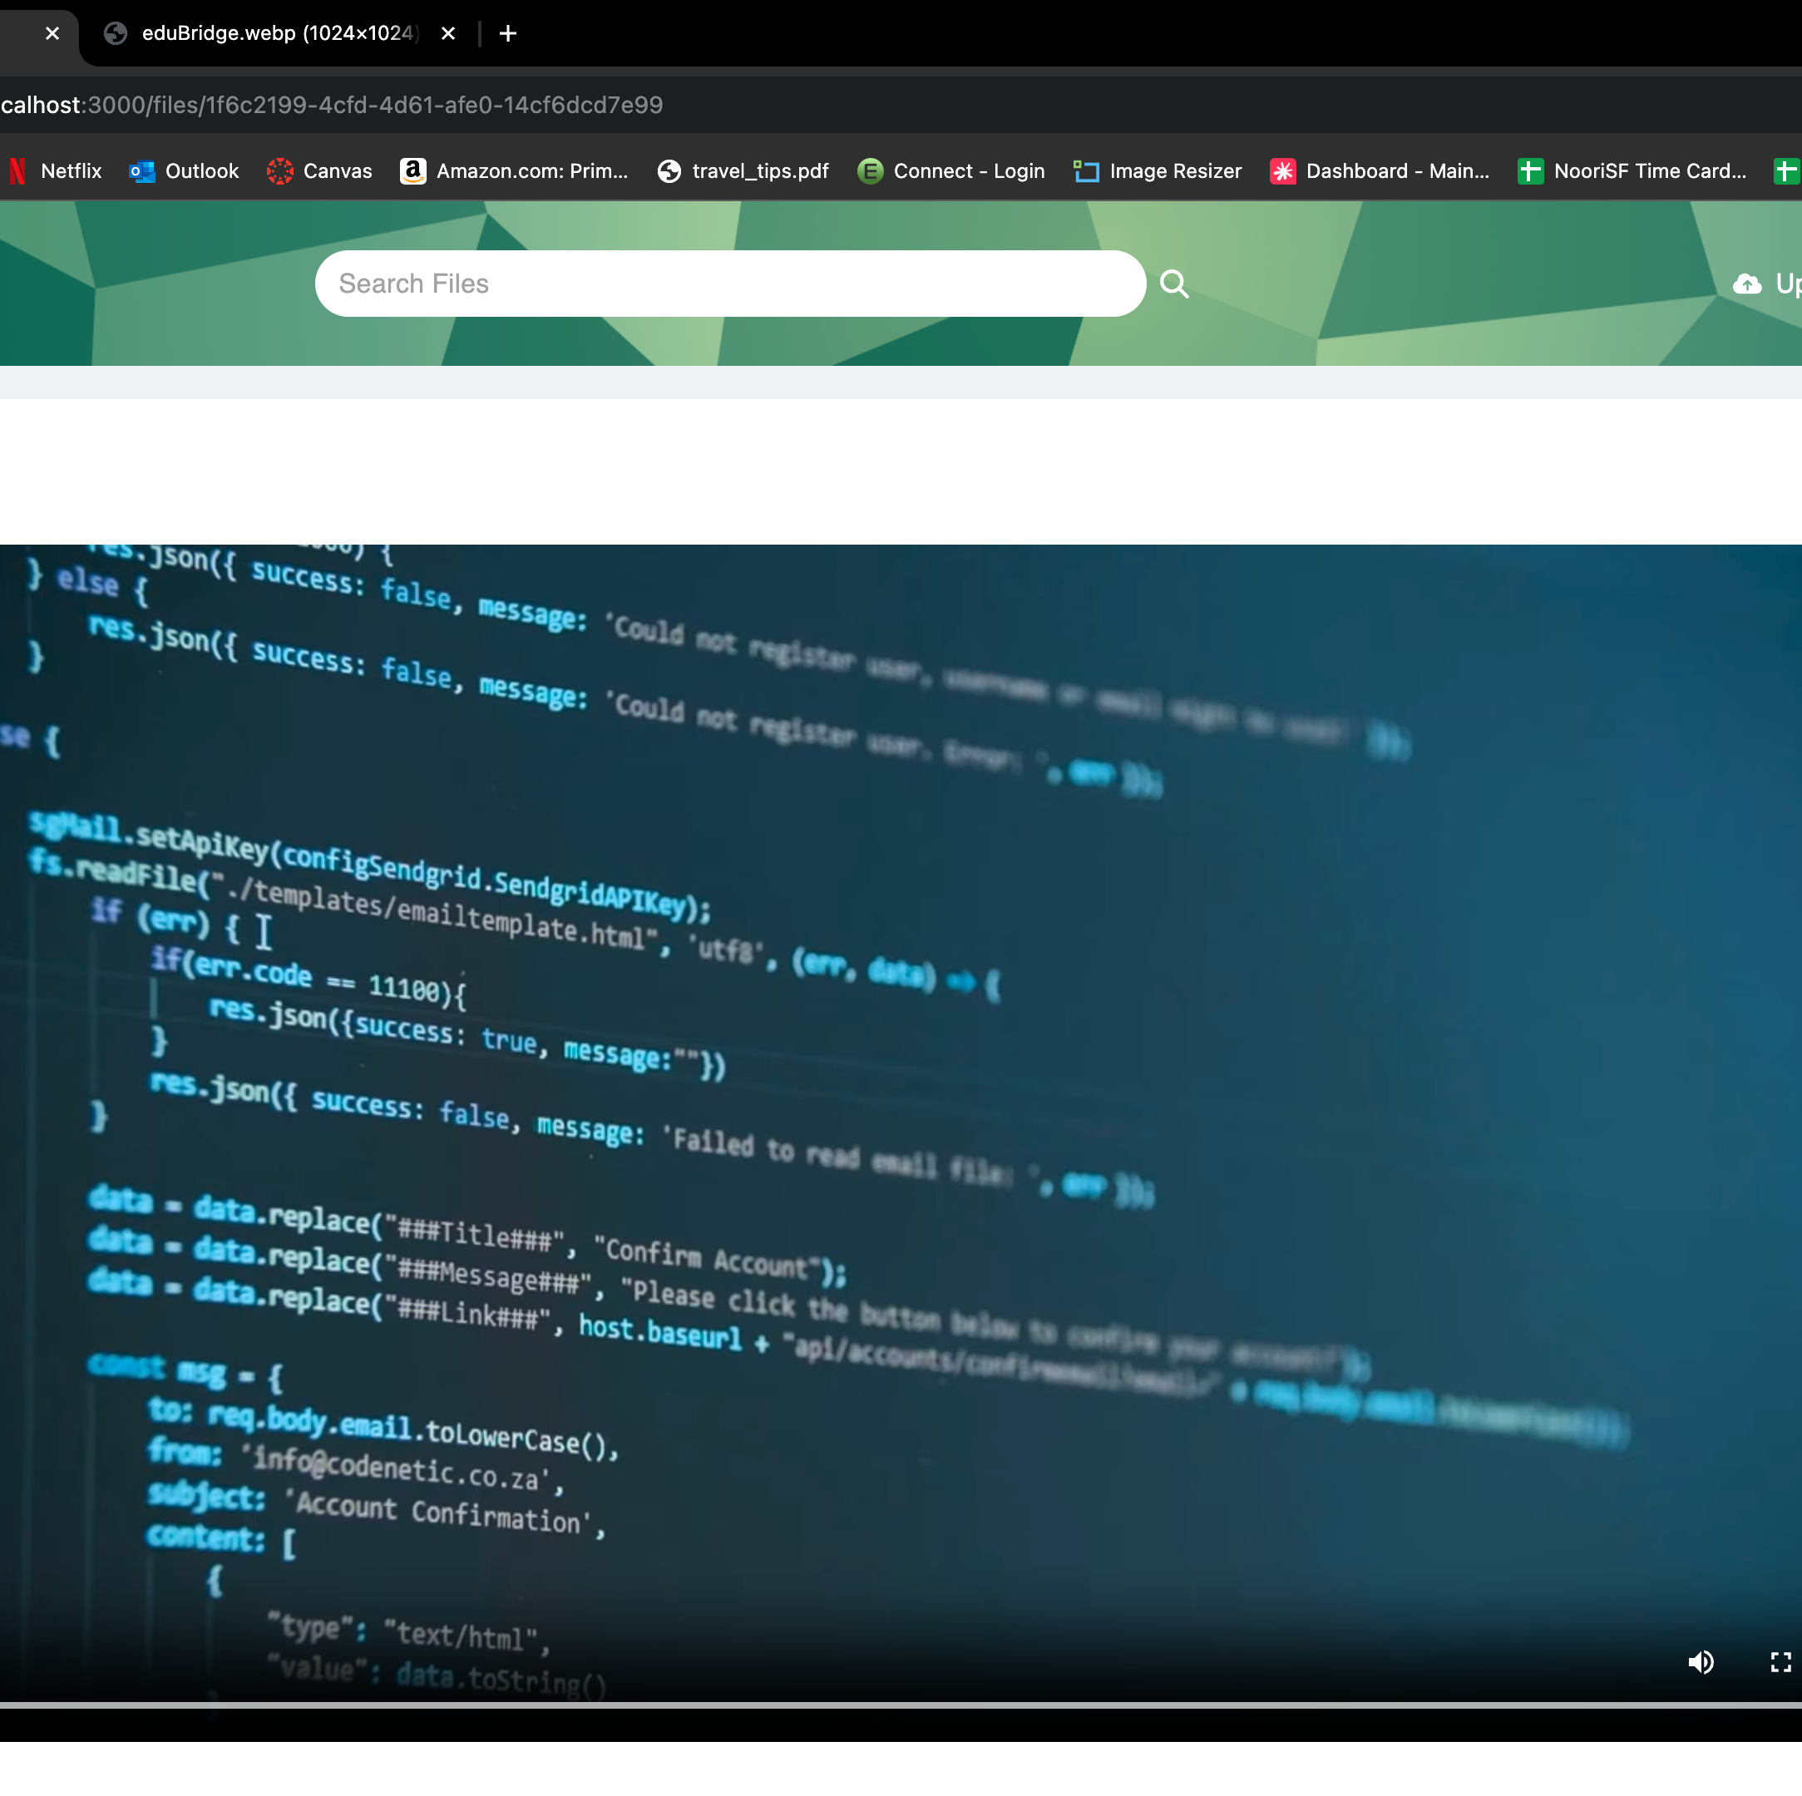
Content Playback
This application offers appropriate playback for common file types.
Able to watch uploaded videos in application.
Due to limit of resources we have ensured if a certain file cannot be viewed, users can download the file to view in their own system.

Slide 9
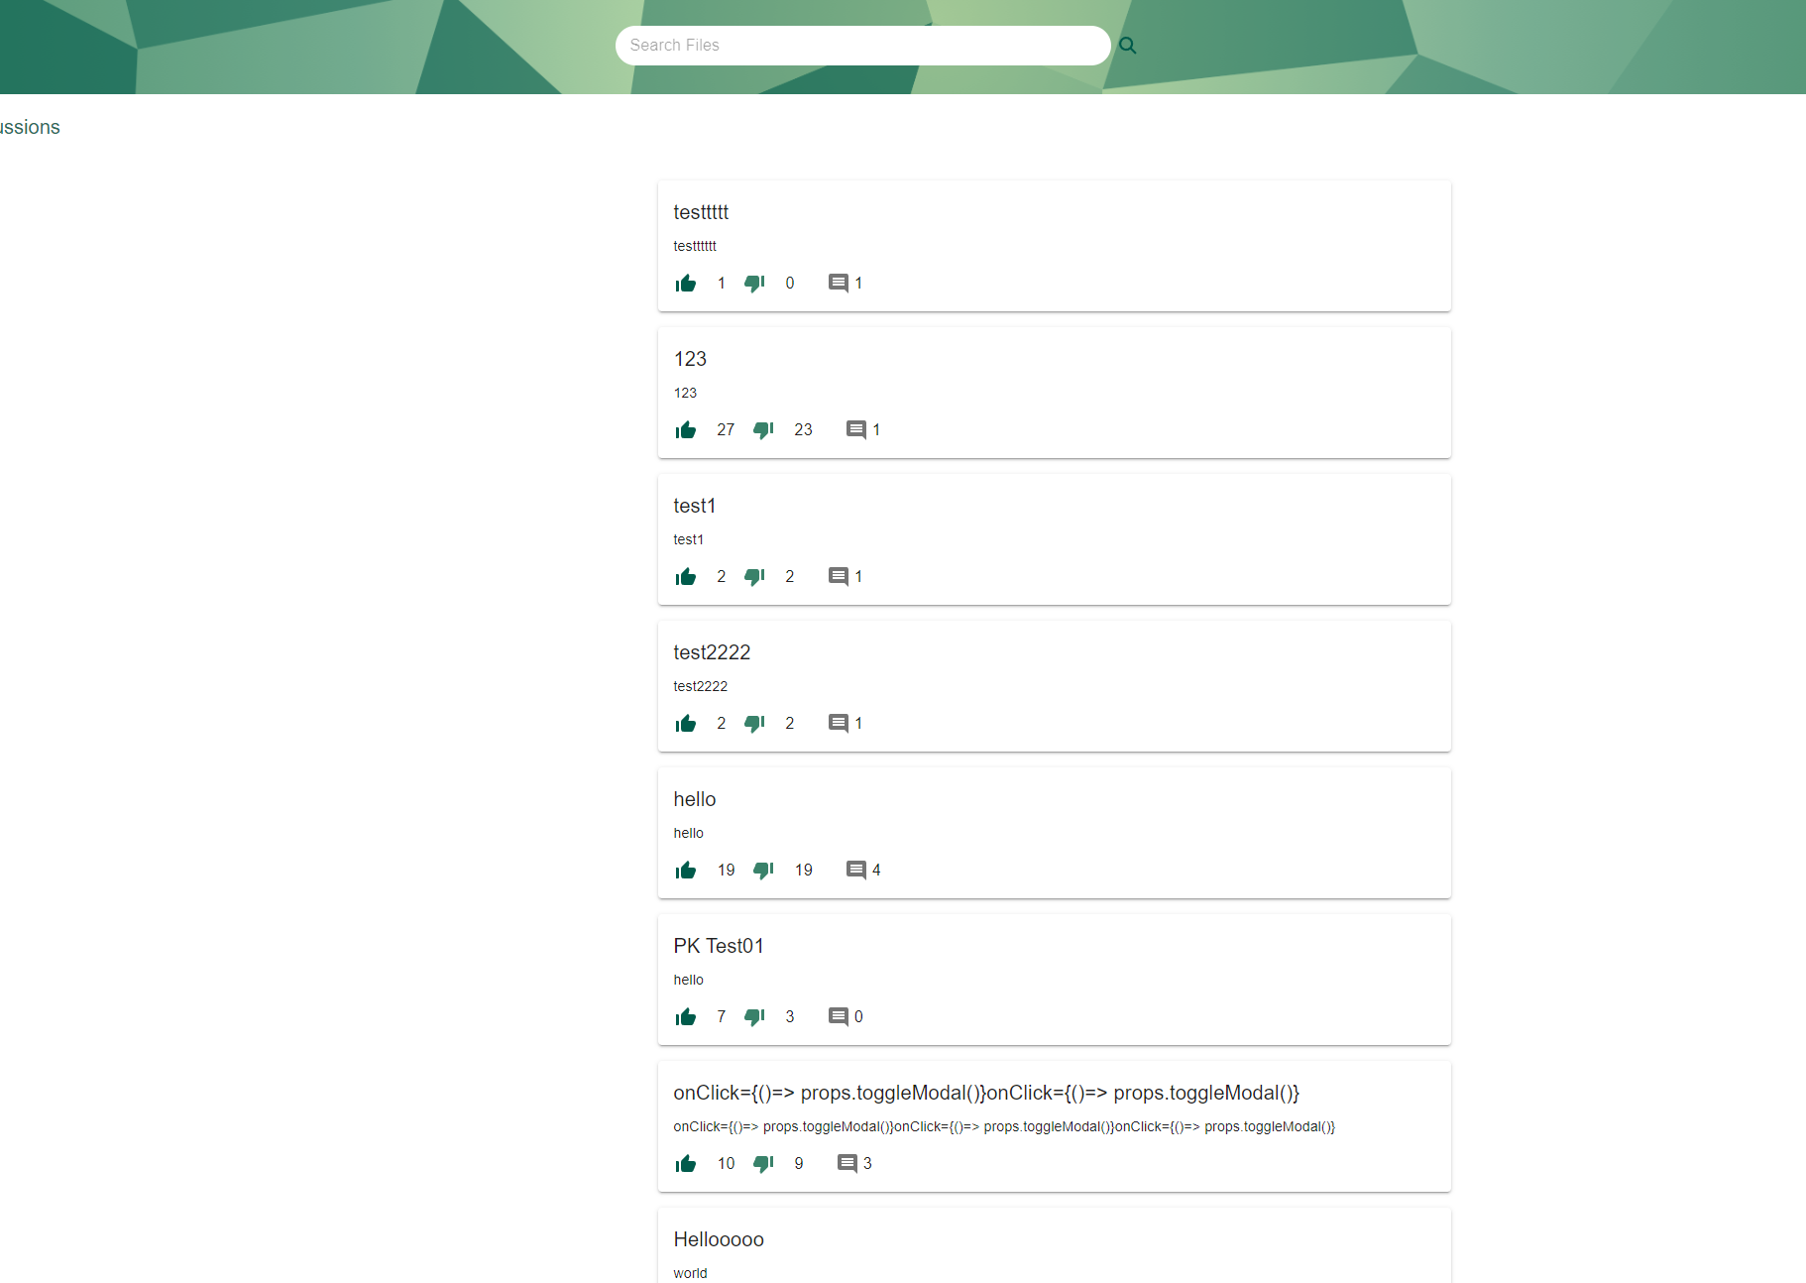
Feedback
Users can create new discussions can engage in discussions,
Users can be able to post comments on discussion and able to like/dislike comments.
Users can also search for discussion using the search bar.

Slide 10
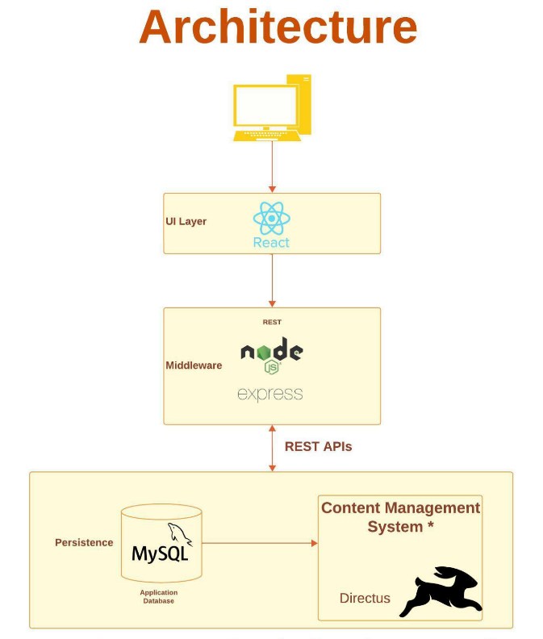
Technologies

Slide 11
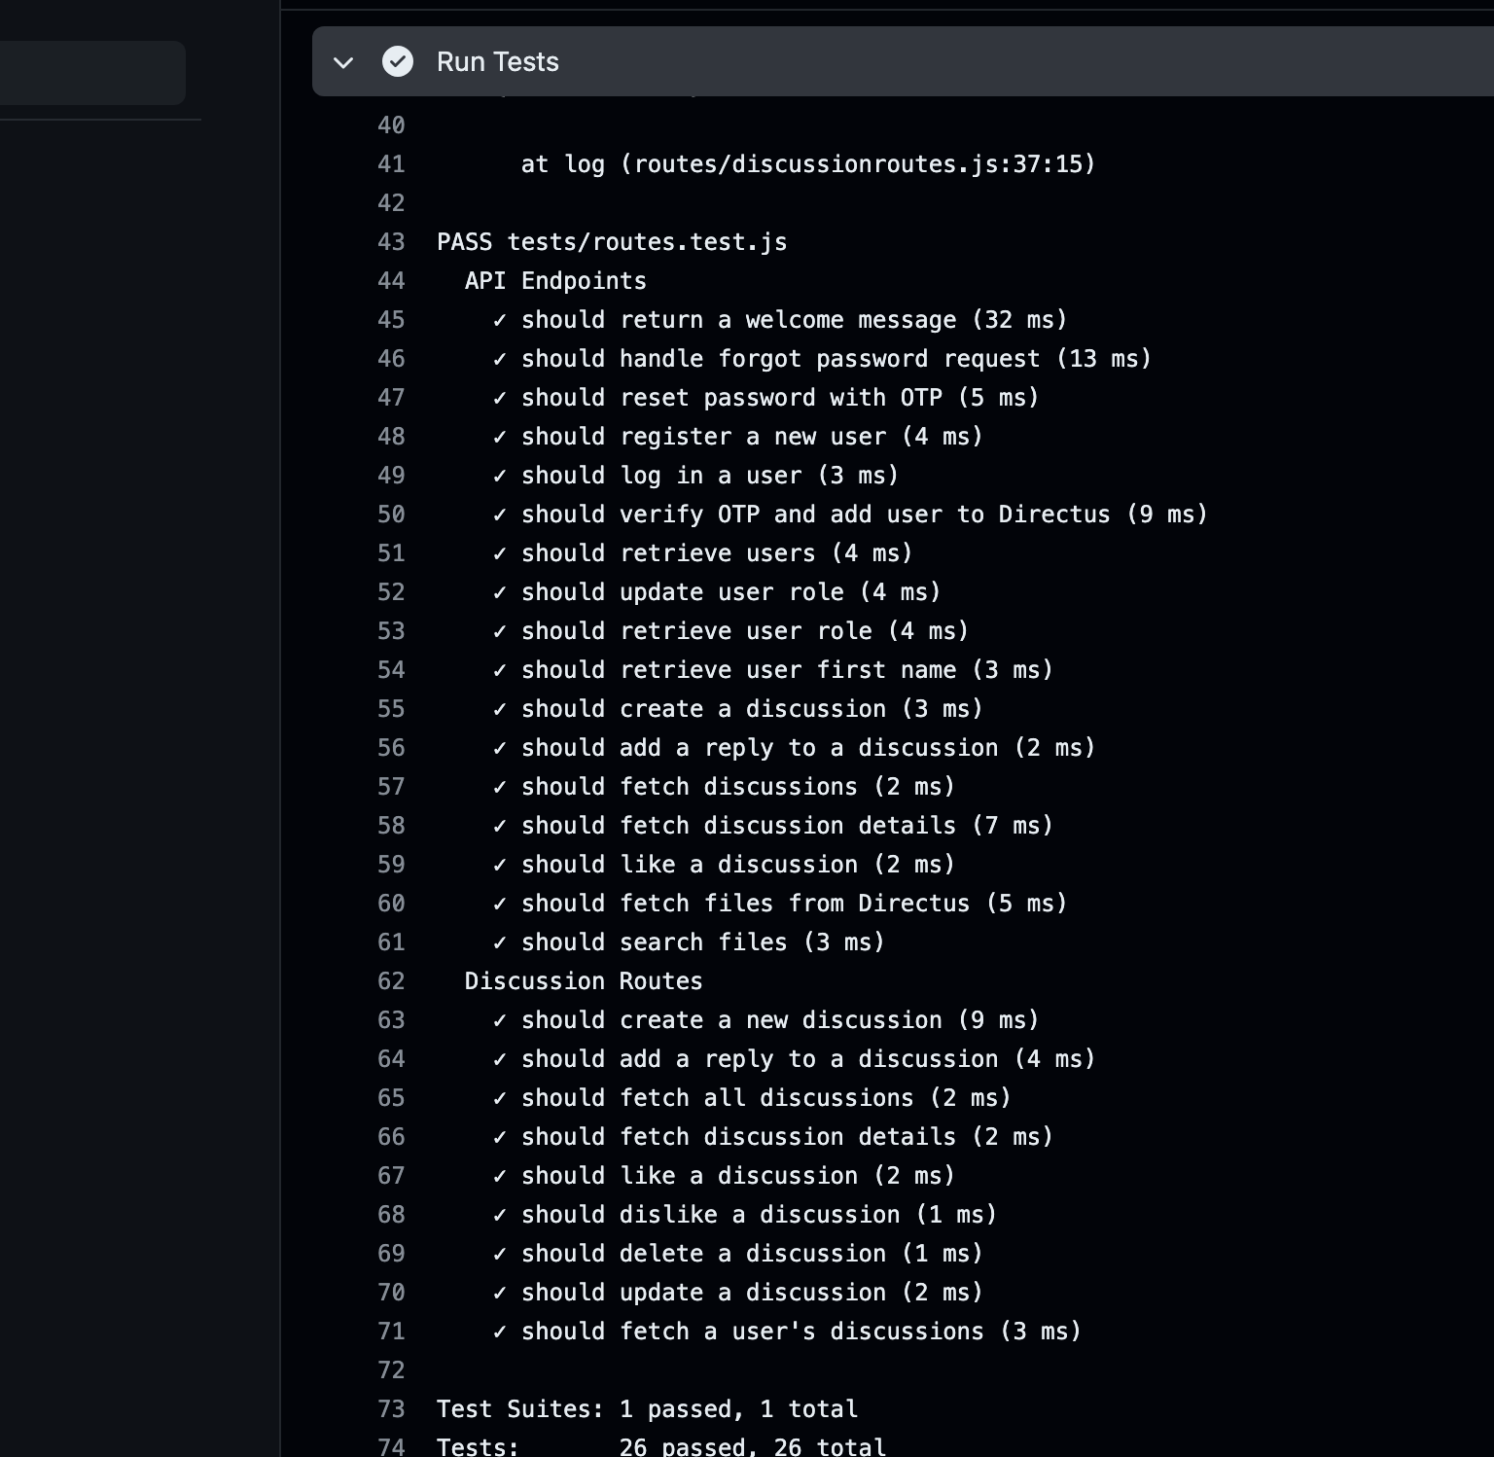
Testing
To ensure that our consumers have no problems using our app, we tested everything before uploading it to the server.

Slide 12
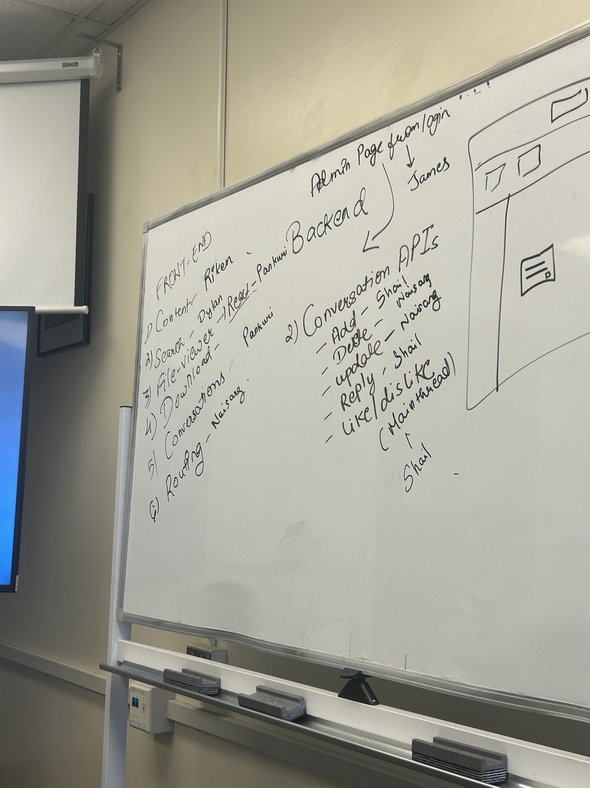

Team Management
Virtual Meeting
Constant Updates on Discord by team members
In – Person Meeting Friday 1:30 PM – 3:00 PM in library
Watched cricket matches together and got into fights (just kidding)

Slide 13
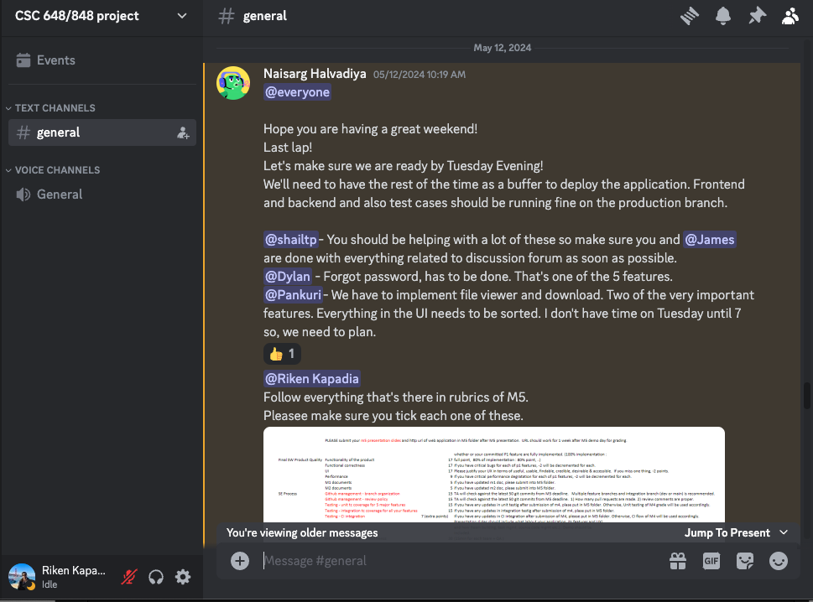
Task Assignment

Slide 14
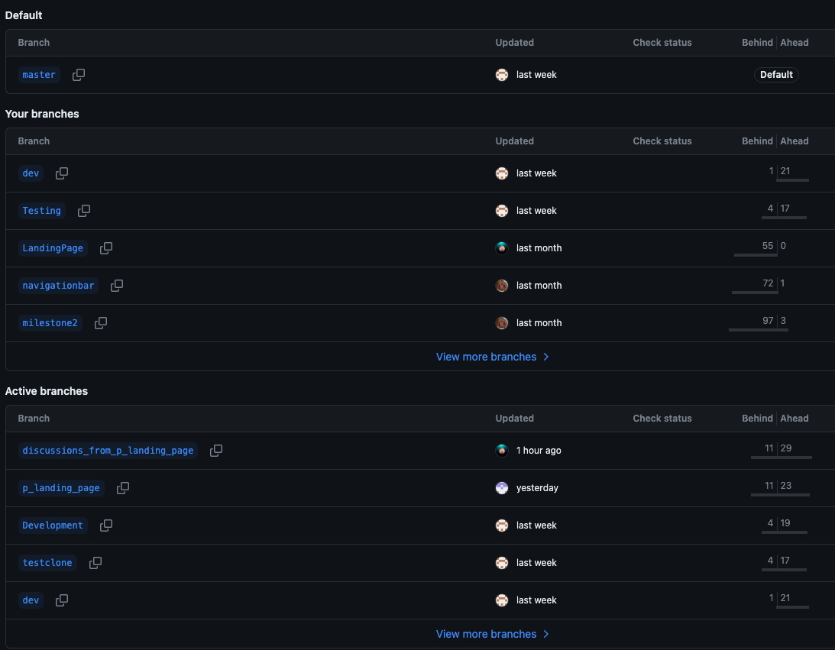
GitHub Branches Management
We made dev branch to implement final Milestone.
All the major changes happened in particular branch to make it simple and clear.

Slide 15
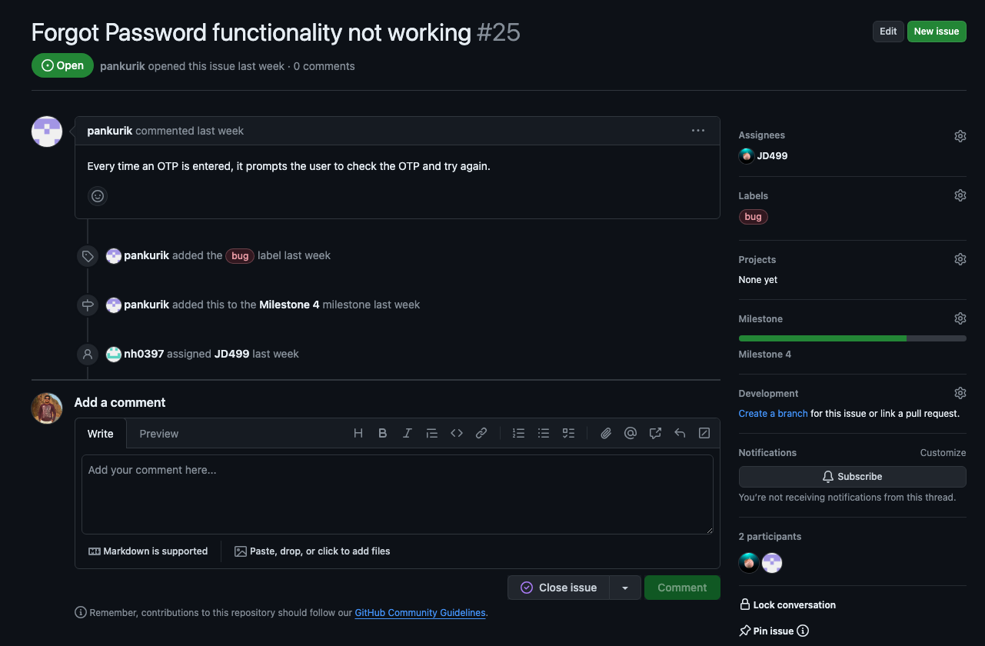
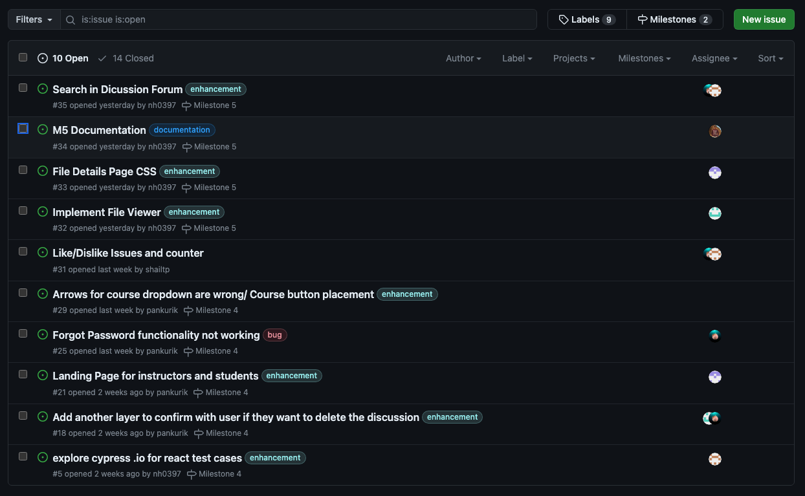
GitHub Issue
Creation of GitHub issues majorly by Team Lead and Front Lead.
Assigning each issue in meetings to specific members.

Slide 16
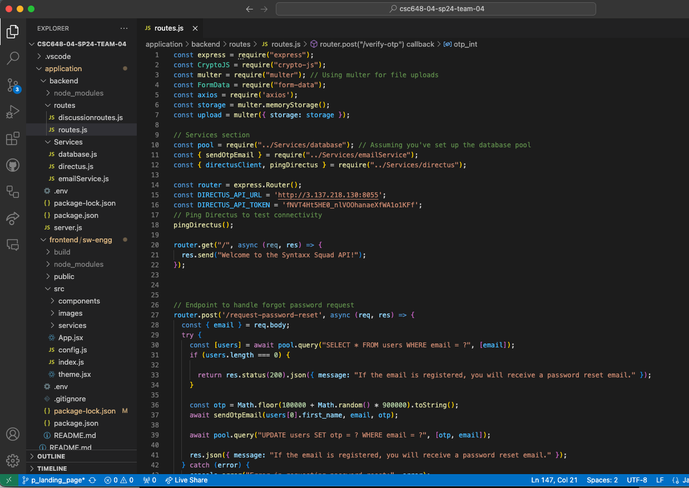
Backend Integration
The backend directory is well-organized and includes several key components for our application.
It contains routes for handling different functionalities, such as discussionroutes.js and routes.js.
The Services folder holds essential service files like database.js for database interactions, directus.js for Directus client operations, and emailService.js for managing email communications.
The tests directory includes the test files, such as routes.test.js, ensuring our routes function as expected.
Additionally, we have configuration files like .env for environment variables, package-lock.json and package.json for managing dependencies, and server-related files like server.js and testServer.js to run and test our server.
This structure promotes maintainability and scalability for our application

Slide 17



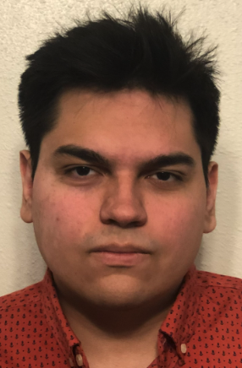



Team Syntaax Squaad
Dylan Nguyen - Scrum Master I
James Dixon - Scrum Master II
Pankuri Khare - Frontend Lead
Naisarg Halvadiya – Team Lead
Shail Patel - Backend Lead
Riken Kapadia - GitHub Master

Slide 18
DEMO !

